Slide 1
Project 3: Defensive Security Project
Team <Five>
Praveen
Dmytro
Janet

Slide 2
Table of Contents
This document contains the following resources:
Monitoring Environment
Attack Analysis
Project Summary & Future Mitigations

Slide 3

Monitoring Environment
‹#›

Slide 4
Scenario
We are SOC analysts at Virtual Space Industries (VSI), a VR program design company.
We are tasked with monitoring against potential cyberattacks by a competitor, JobeCorp, using Splunk as our SIEM
We monitored the VSI's administrative webpage, Apache web server, and the Windows Server Environment
The Windows Server contains VSI's next-generation virtual-reality program intellectual property, and the Apache Server is used for VSI's main public-facing website, vsi-company.com.
We created Baselines and reports using past logs provided by the networking team, including Windows Server Logs and Apache Server Logs.

Slide 5
Splunk Security Essentials
‹#›
Notes:
our chosen add on monitoring network activity

Slide 6
Splunk Security Essentials
A summary of the product
Free security application for organisations
Provides best practices, use cases, and examples to improve security posture
Includes over 50 use cases covering various security areas
Designed to be easy to deploy and customise
Provides dashboards and visualisations to monitor and analyze security data
Helps organisations quickly identify potential threats and take appropriate action

Slide 7
Splunk Security Essentials
Large organisation struggling to keep up with volume of cyber threats and incidents
Implementing Splunk Security Essentials provides pre-built use cases and best practices to address these challenges
Benefits include:
Quickly identifying and prioritising critical threats
Taking action more quickly and effectively
Tracking and monitoring effectiveness of security measures using dashboards and visualisations
Over time, the organisation's security posture improves significantly
Improved security leads to:
Proactively identifying and mitigating potential threats
Improved business outcomes
Increased customer trust.

Slide 8
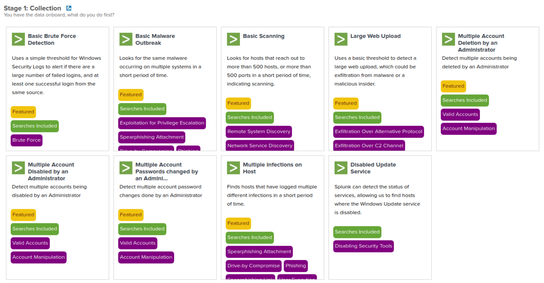
Splunk Security Essentials
Select one of many search options
Notes:
splunk search options

Slide 9
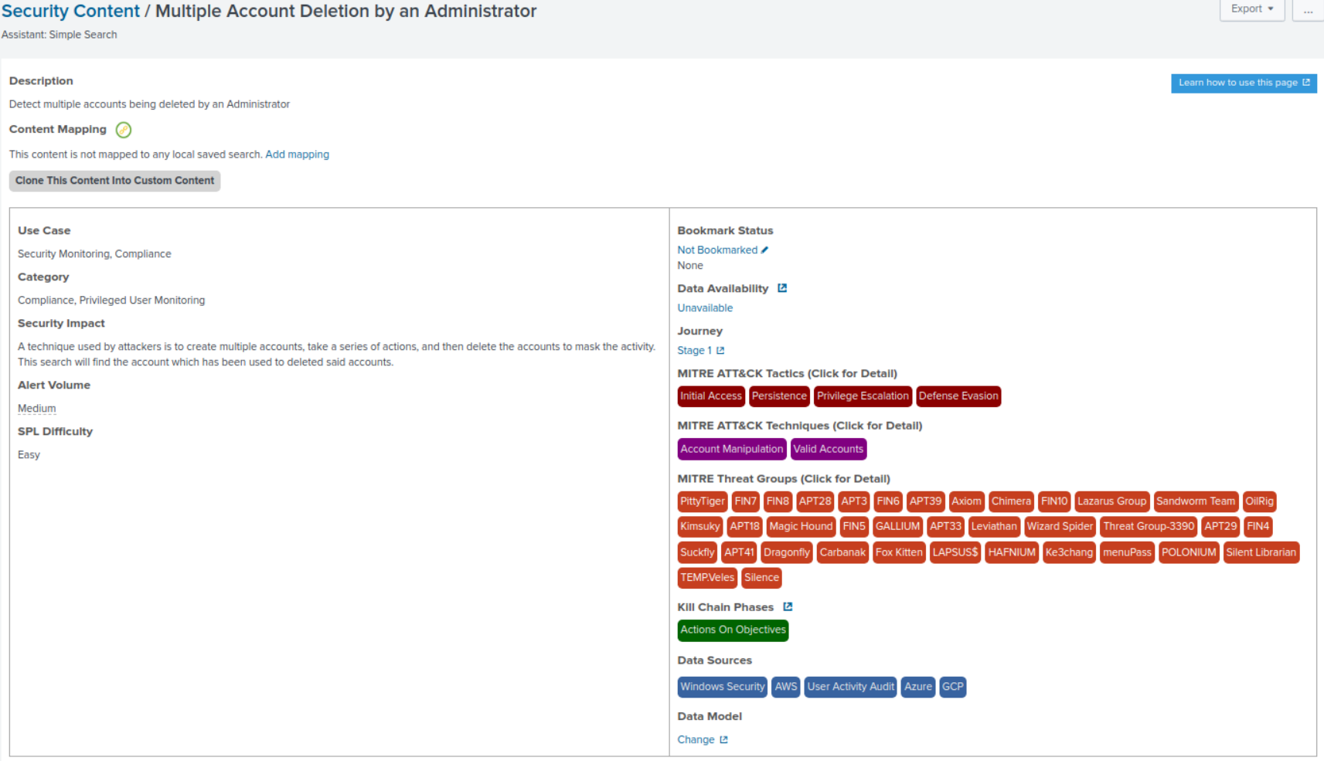
Splunk Security Essentials
Example: Selecting Multiple Account Deletion by an Administrator

Slide 10
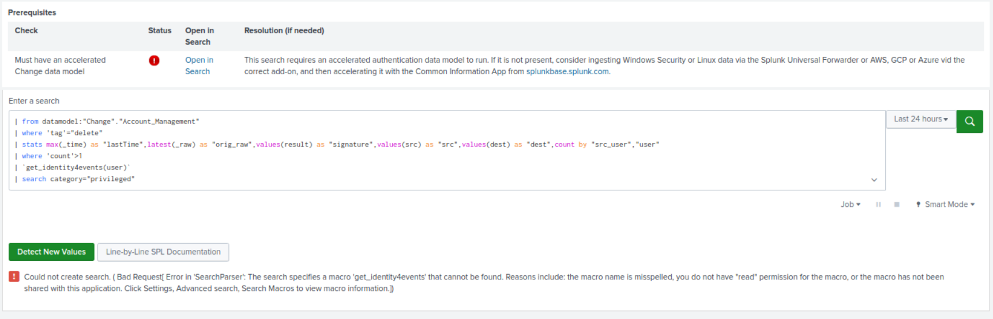
Splunk Security Essentials
Also on this page you get the code required to run this search

Slide 11
Logs Analyzed
Windows Logs
Apache Logs
1
2
These are system logs for a windows server that contains VSI’s intellectual property and contain information such as:
Events and their signatures
Severity of events
The user associated with events
Time and date of events
These are the logs for an Apache server used to host VSI’s public-facing website and contain useful information such as:
Different HTTP request methods
Client IPs and their locations
Response status codes
Request URLs
Referrers
Timestamps

Slide 12
Windows Logs
‹#›

Slide 13
Reports—Windows
Designed the following reports:
Report Name | Report Description
Signatures and their IDs | A report with a table of signatures and their associated IDs
Severity Level and Percentage | A report showing the different severity levels of windows events aswell as what percentage of total events each severity is. Allowing for quick detection of spikes in severity levels
Success vs Failure rate | A report showing the total number of success’s and failures of windows events.

Slide 14
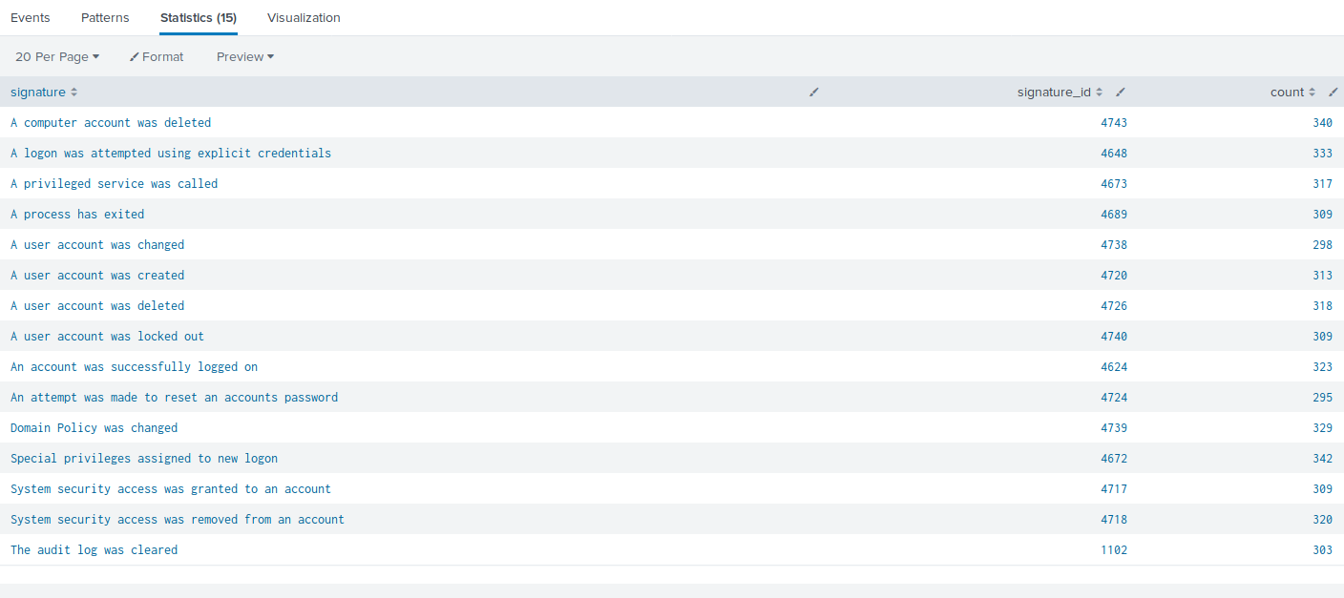
Report 1 - Signatures and their IDs
Command: source="windows_server_logs.csv" host="Windows_server_logs" sourcetype="csv"i | dedup signature | stats count by signature_id | table signature, signature_id, count

Slide 15
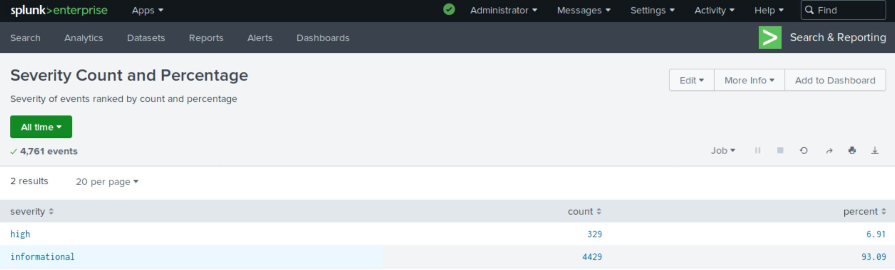
Report 2 - Severity Levels and Percentage
Command: source="windows_server_logs.csv" host="Windows_server_logs" sourcetype="csv" | stats count by severity | eventstats sum(count) as total | eval percent=round(count*100/total, 2) | table severity, count, percent

Slide 16
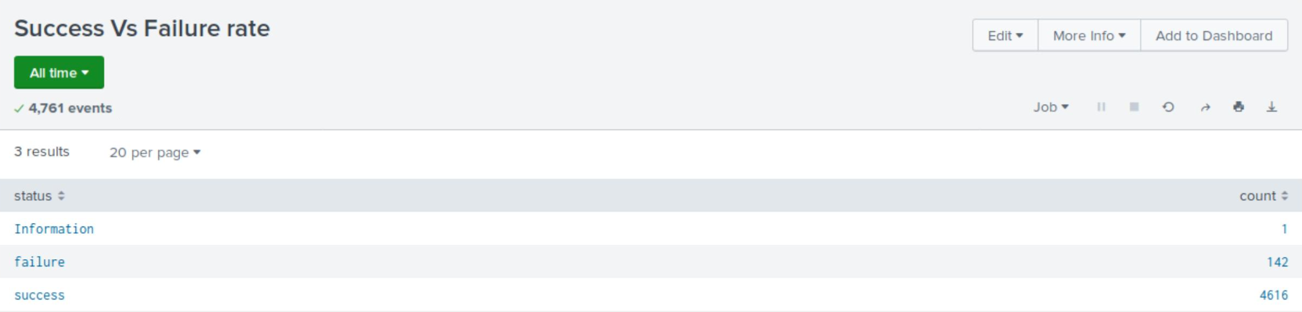
Report 3 - Success vs Failure rate
Command: source="windows_server_logs.csv" host="Windows_server_logs" sourcetype="csv" | stats count by status | table status, count

Slide 17
Alerts—Windows
Designed the following alerts:
Alert Name | Alert Description | Alert Baseline | Alert Threshold
Windows Failed Activity | An alert that is triggered if a threshold of failed events in windows is met each hour | 9 events | >15 events
JUSTIFICATION: 9 events seemed to be the average occurrence of events during normal operating conditions. Allowing a small amount for natural variance we decided on 15 as a threshold for an alert as we deemed any number of events over this amount worth investigation

Slide 18
Alerts—Windows
Designed the following alerts:
Alert Name | Alert Description | Alert Baseline | Alert Threshold
Successful Login Alert | An alert that tracks the signature of success logins | 20 | 30
JUSTIFICATION: The alert baseline for the number of successful logins is 20 in an hour. we deemed anything over 30 to be a potential threat and worth investigating.

Slide 19
Alerts—Windows
Designed the following alerts:
Alert Name | Alert Description | Alert Baseline | Alert Threshold
A User Account was Deleted | An alert is triggered when an excessive amount of user accounts are being deleted | Approx. 16 | 30
JUSTIFICATION: The alert baseline is approximately 16 user accounts deleted within an hour. We deemed anything greater than 30 accounts deleted in an hour as a potential threat and worth investigating.

Slide 20
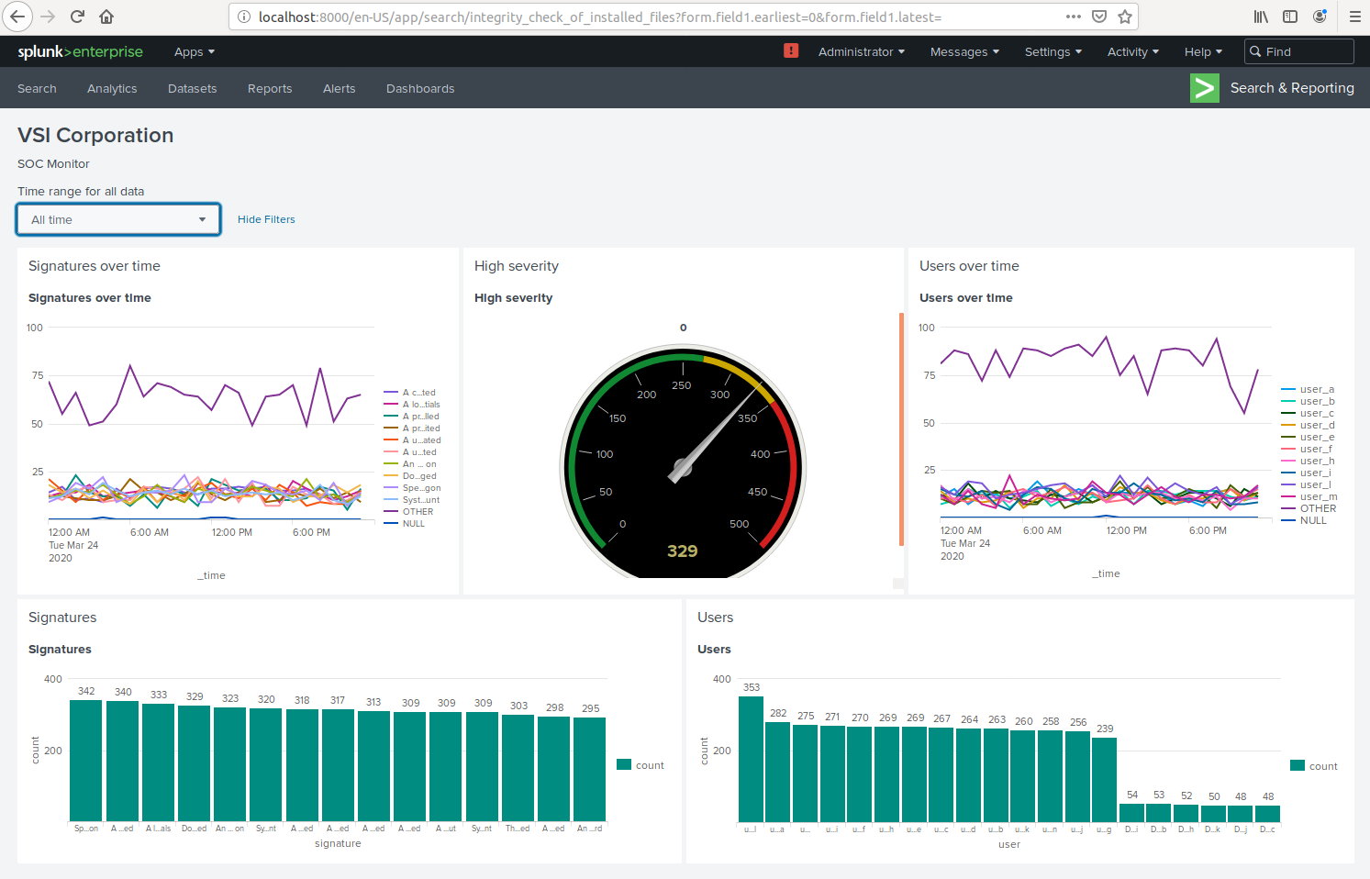
Dashboard
Our final Dashboard for Windows Server looks like this:

Slide 21
Apache Logs
‹#›

Slide 22
Reports—Apache
Designed the following reports:
Report Name | Report Description
HTTP method Reports | A report with a table of the different HTTP methods
Referrer Domains | A report that shows the top 10 domains that refer to VSI’s website
HTTP Response Code | A report that shows the count of each HTTP response code

Slide 23
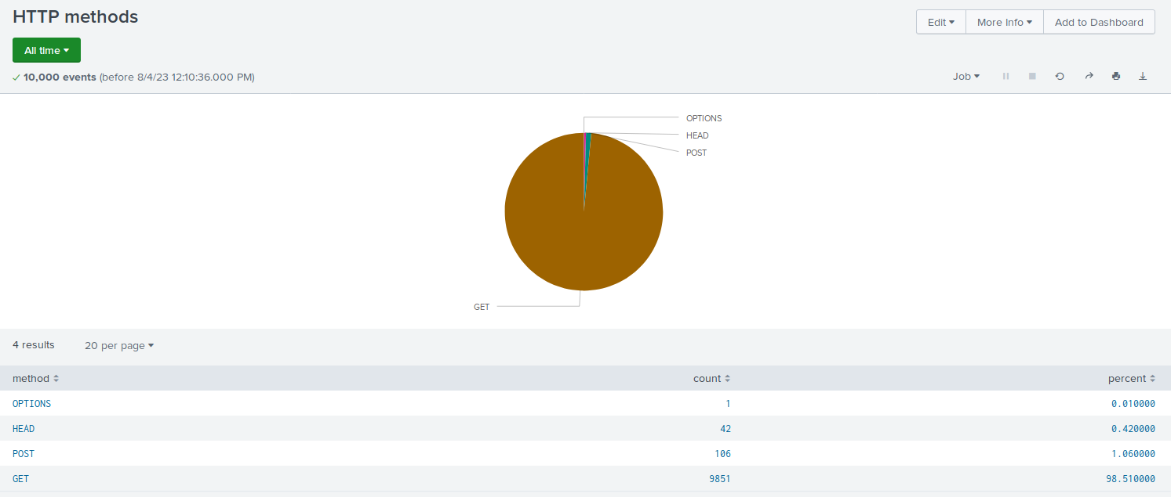
Images of Reports—Apache
Command: source="apache_logs.txt" host="Apache_logs" sourcetype="access_combined" | stats count by method

Slide 24
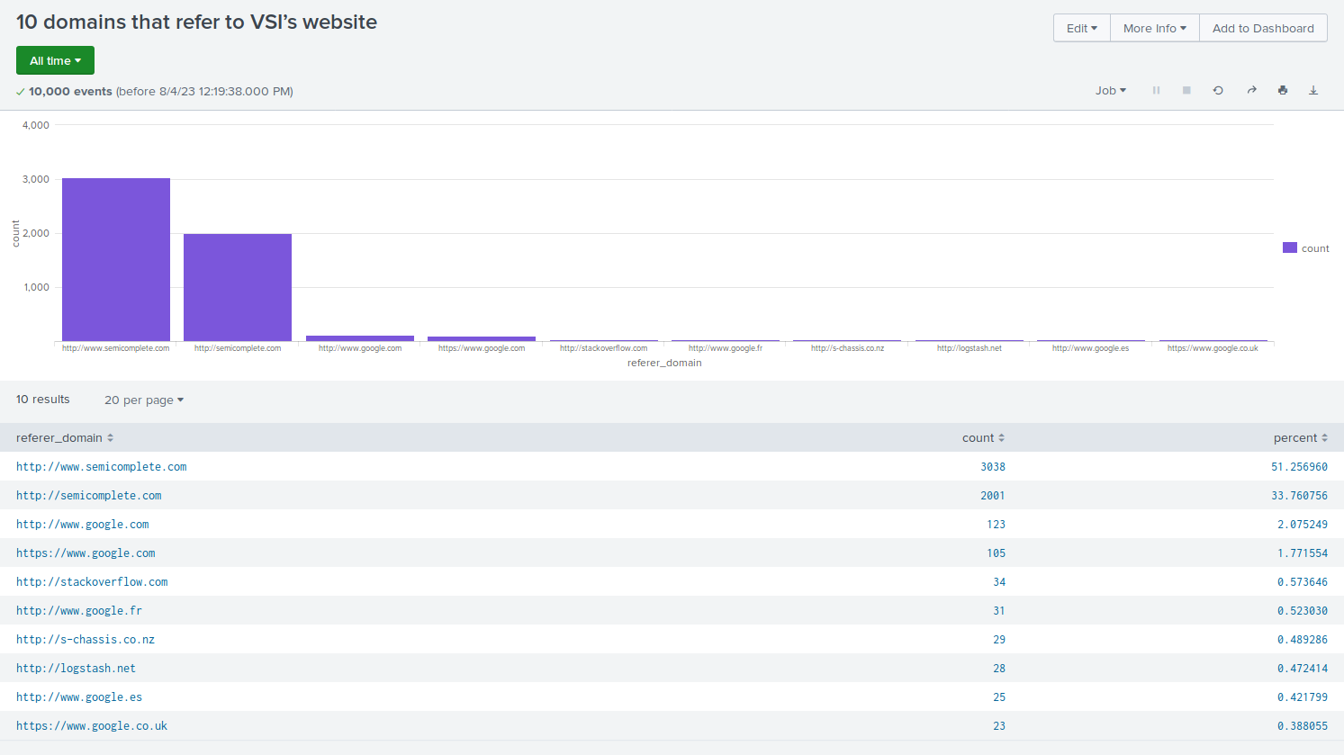
Images of Reports—Apache
Command: source="apache_logs.txt" host="Apache_logs" sourcetype="access_combined" | top limit=10 referer_domain

Slide 25
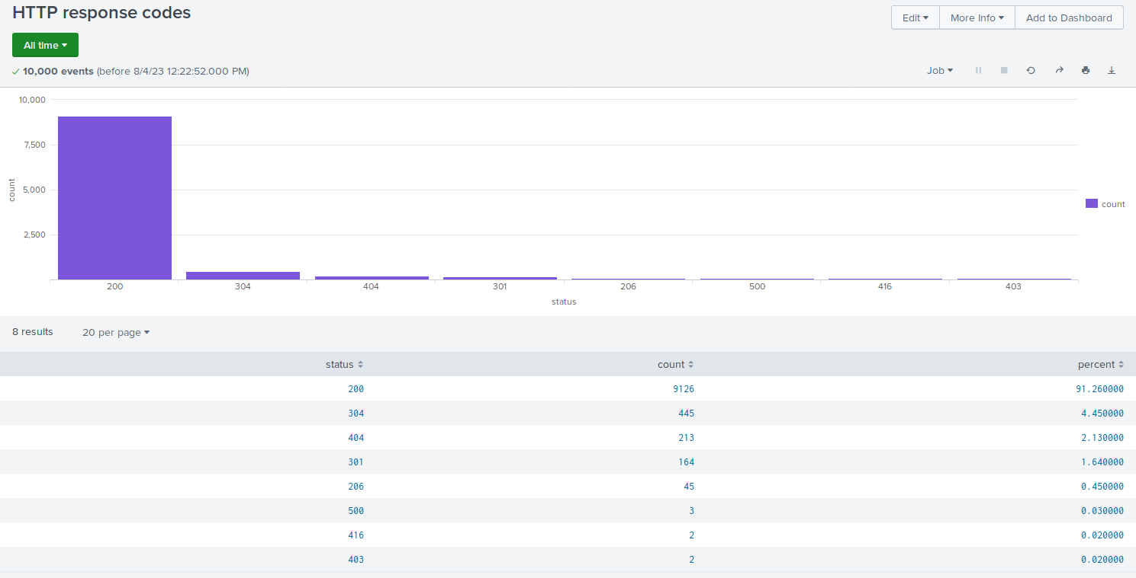
Images of Reports—Apache
Command: source="apache_logs.txt" host="Apache_logs" sourcetype="access_combined" | stats count by status

Slide 26
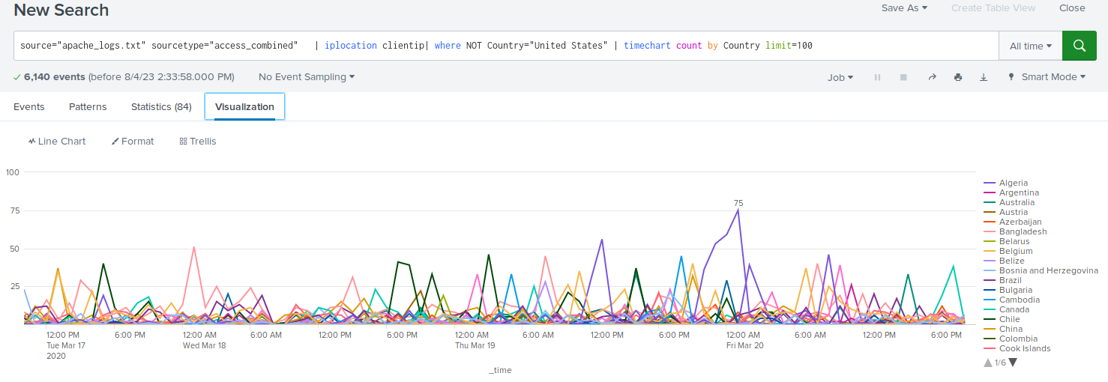
Hourly Country count by country (USA excluded)

Slide 27
Alerts—Apache
Designed the following alerts:
Alert Name | Alert Description | Alert Baseline | Alert Threshold
Countries other than US | An alert for an abnormal amount of visits from IP’s outside the US | Approx. 50 | >80
JUSTIFICATION: The Alert Baseline is approximately 50 per hour which is fairly standard. So, we deemed anything over 80 should trigger the alert and is worth investigating for potential malicious attacks.

Slide 28
Alerts—Apache
Designed the following alerts:
Alert Name | Alert Description | Alert Baseline | Alert Threshold
POST Requests | An alert for excessive amount of Post Requests | Approx. 10 | >20
JUSTIFICATION: The Alert Baseline is approximately 10 Post Requests per hour. We deemed anything over 20 Post Requests per hour as a potential threat and worth investigating.

Slide 29
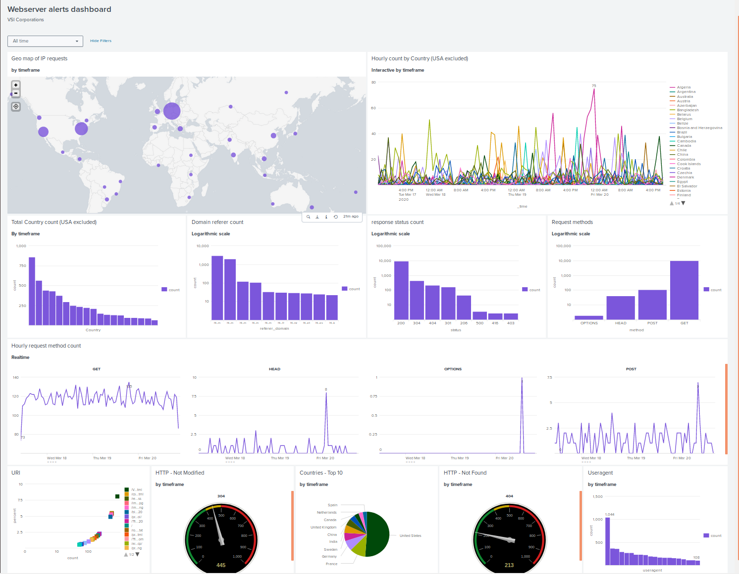
Dashboard—Apache

Slide 30
Attack Analysis
‹#›

Slide 31
Attack Summary—Windows
There was a substantial increase in the severity of the windows events from 6.91% (329 events) to 20.23% (1111 events)
There was a considerable spike in the amount of failed windows events at 8am on Wednesday the 25th of March 2020 which triggered an alert
There was a suspicious amount of successful logins for a ‘user_j’ between the hours of 11am and 1pm on the 25th
Between the hours of 1am and 3am there was a drastic increase in user accounts being locked out
9am-11am showed a large amount of attempts to change account passwords
There was a drastic increase in usage for 2 users:
user_a between 12am and 3am
user_k between 8am and 11am

Slide 32
Attack Summary—Windows
We had 3 alerts in place:
Failed Windows activity:
We determined a good baseline to be ~9 events per hour
We set the threshold for the Alert to be 15 events per hour
The attack would have triggered the alert as 35 events took place during the hour of the attack, so we were happy with the threshold
Successful Logins:
Normal operating baseline was ~20 events per hour
We set our threshold for 30 events per hour
The attack would have triggered the alert as 273 events took place.
Deleted Accounts:
Normal operating baseline was ~16 events per hour
We set our threshold for 30
The attack would not have triggered an alert as there was no increase in deleted accounts.

Slide 33
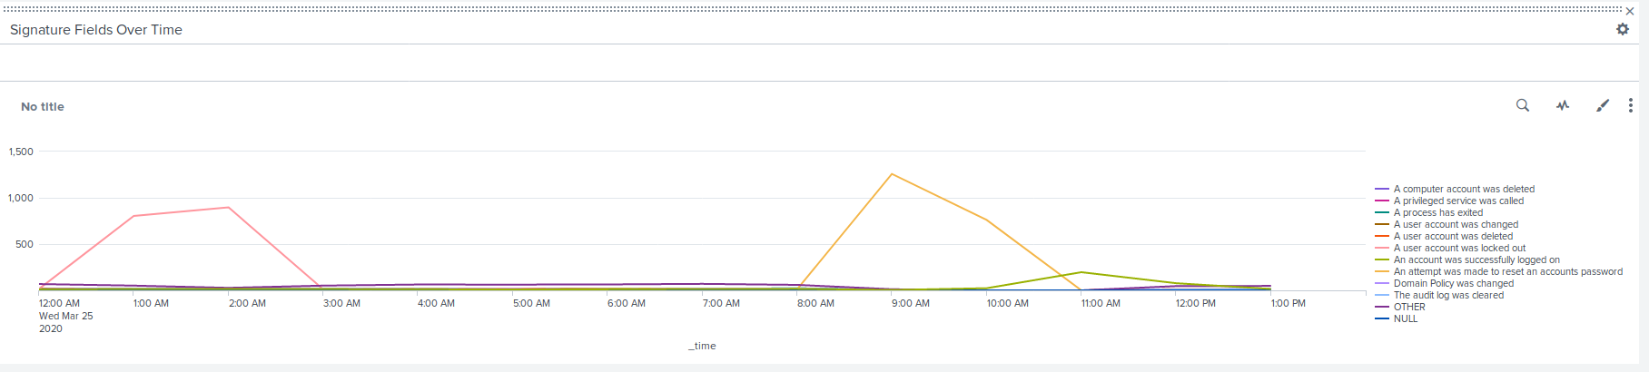
Attack Summary—Windows
Our dashboards proved extremely useful in helping to visualise the attacks taking place. Some examples are as follows:
There are 2 significant spikes in the windows event signatures showing:
An increased number of locked out users between 12am-3am
An increased number of attempts to change passwords between 8am-11am

Slide 34
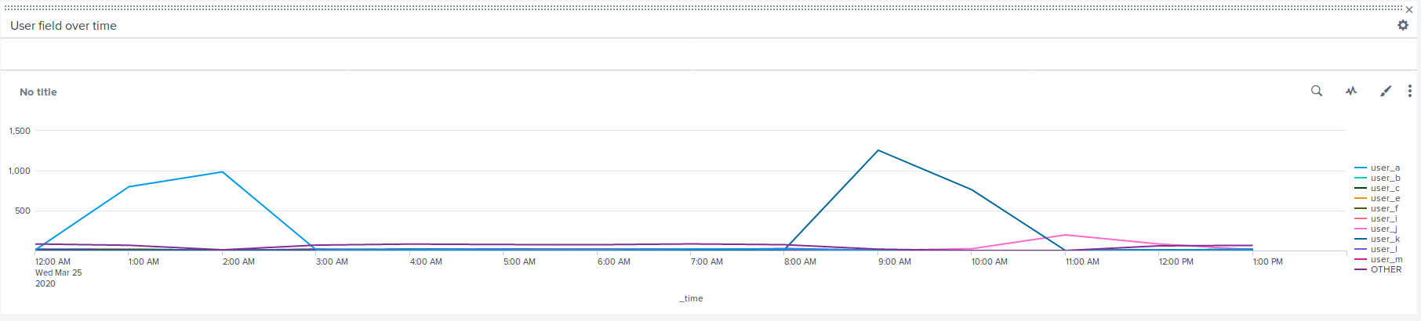
Attack Summary—Windows
The line chart showing user activity shows 2 abnormal spikes:
user_a: 12am-3am
user_k: 8am-11am

Slide 35
putting these graphs side by side suggests that:
user_a was attempting to brute force in and kept getting locked out
user_k was attempting to change user passwords

Slide 36
Attack Summary—Apache
There was a substantial increase in the amount of HTTP POST request methods indicating a possible brute force or DoS attack
There was a large increase in the amount of 404 error codes (624 events in one hour) which could indicate any of the following attacks:
Brute force
Directory traversal
DoS
Bot attacks
The amount of international activity spiked significantly, especially from the Ukraine
There was a disproportionate amount of visits to the /VSI_Account_login.php URI also suggesting a brute force attack

Slide 37
Alert Summary—Apache
We had 2 alerts in place:
Activity in countries other than the US
The standard logs suggested a baseline of ~50 events per hour
We decided to set our alert threshold for >80 events per hour
The attack peaked at 939 events between 8am-9am
this would have triggered the alert so we were happy with our threshold
HTTP POST activity
The baseline during normal conditions was ~10 per hour
We set our threshold for >20 events per hour
The attack peaked at 1296 which exceeded our threshold by over 6000% so whilst it definitely triggered the alert it might indicate it needs to be raised slightly to avoid false positives in the future.

Slide 38
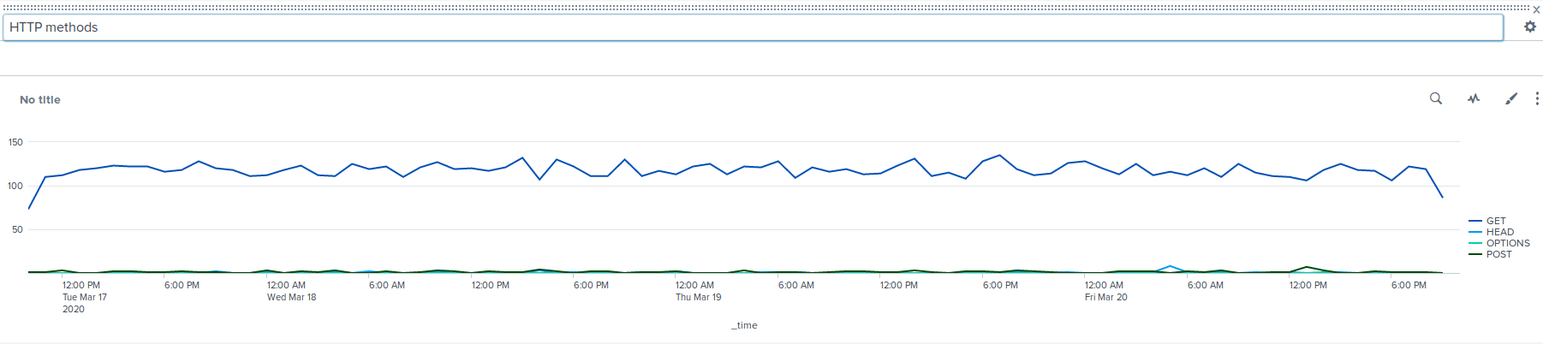
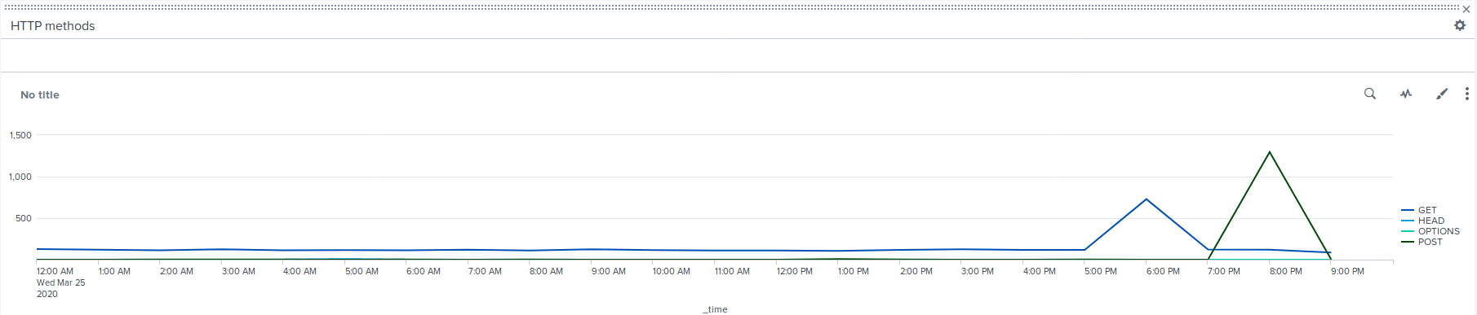
Dashboard Summary—Apache
HTTP request methods during normal conditions:
During the attack:

Slide 39
Dashboard Summary—Apache
There is a large spike in POST requests from 7pm to 9pm which could suggest the following attacks:
Brute force
XXS and SQL injection
DoS
Malware distribution
There is also a slightly smaller spike in GET requests between the hours of 5pm and 7pm which could be indicators of:
DoS
Vulnerability scanning
Directory traversal
Brute force

Slide 40
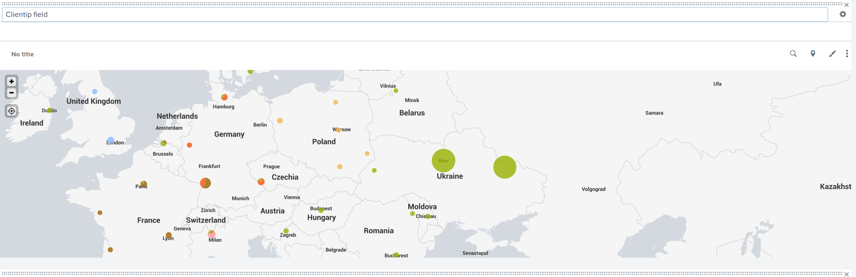
Dashboard Summary—Apache
Zoomed into Europe:
As you can see there has been a substantial increase in client IPs visiting from the Ukraine. In particular Kiev and Kharkiv

Slide 41
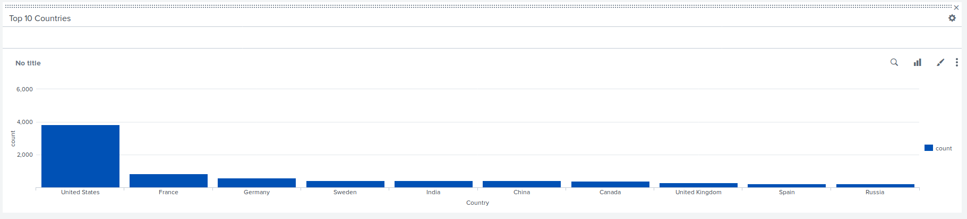
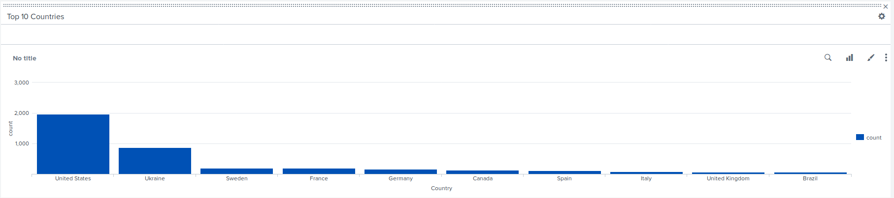
Dashboard Summary—Apache
This can also be visualised in the column graphs showing the top 10 visiting countries:
Normal operating conditions:
During the attack:

Slide 42
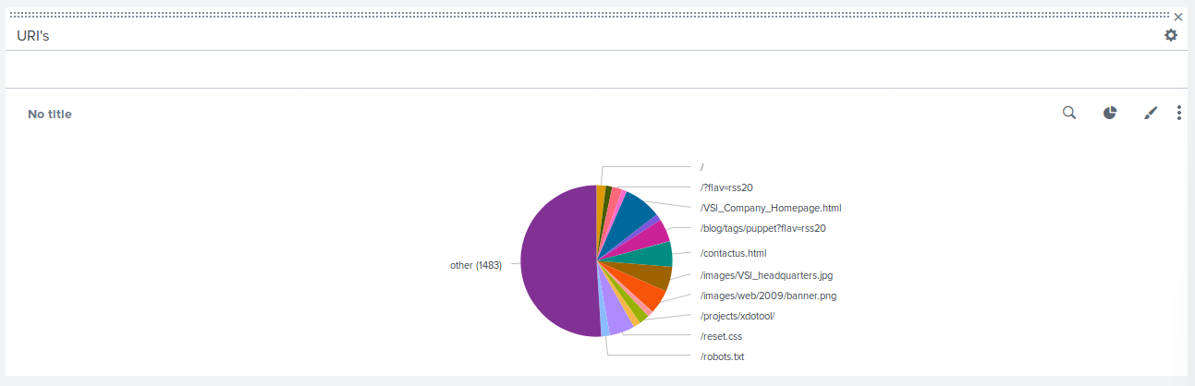
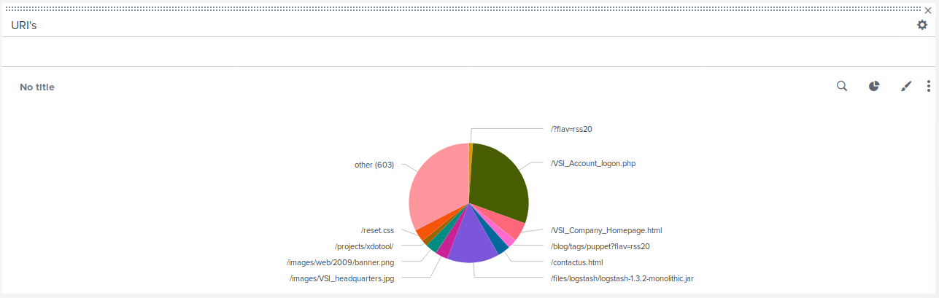
Dashboard Summary—Apache
URI visits under normal conditions:
URI visits during the attack

Slide 43
Summary and Future Mitigations
‹#›

Slide 44
Project 3 Summary
Windows server attack summary:
Significant increase in severity of windows events, indicating a large array of security threats
Suspicious amount of successful logins and an increase locked out accounts strongly indicating credential stuffing or brute force attacks
a large amount of attempts to change passwords indicating potential password spraying or guessing attacks
a drastic increase in usage for two users indicating potential insider threats or compromised accounts.
Mitigations:
Implement MFA (multifactor authentication)
Monitor and limit failed login attempts
Implement strong er password policies
Implement captcha to slow down login process

Slide 45
Project 3 Summary
Apache server attack summary:
A substantial increase in POST requests and 404 errors indicates potential brute forcing or DoS attacks
the disproportionate amount of visits to the /VSI_Account_login.php URI suggests a targeted attack on the login page
The increase in international activity, especially from Ukraine, suggests potential malicious activity from abroad
Mitigations
Implement web application firewall (WAF) to mitigate brute force and DoS attacks
Implement IP blocking for malicious actors and monitor traffic for suspicious behaviour
Use MFA
recheck and sanitize websites for SQL injection and Cross-scripting attacks

